Slide 1


Improvement of Toffoli-n gate fidelity for Grover’s search algorithm
Subtitle : Confirm QPU system stability
Hwan-Seop Yeo, Seungwook Woo, Beomgyu Choi
2022-June.-16th
Week 5
Notes:
Good morning, In this presentation, I’d like to talk about on-going research, The growth and optical characterization of a site-controlled thee-fold symmetric III-nitride quantum dot grown by MOCVD

Slide 2
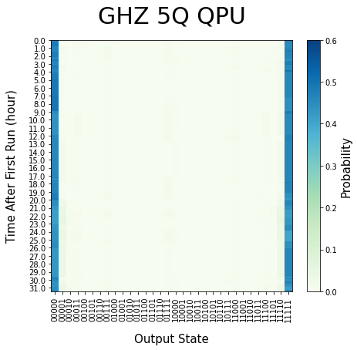
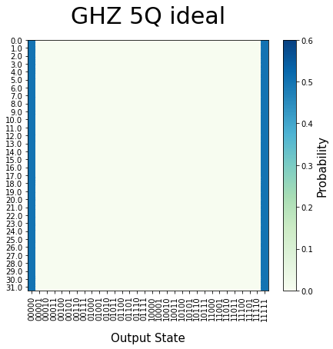
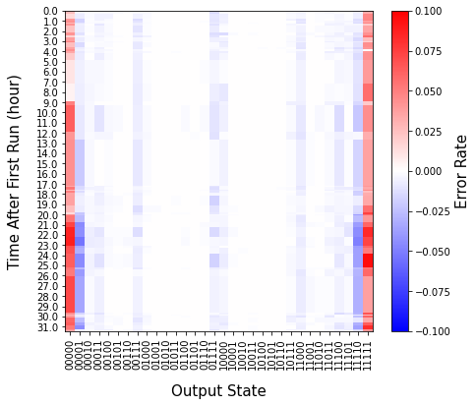
Test Stability of IonQ QPU
QPU
Probability
Ideal
Probability
-
=
Errors
-
=

Slide 3
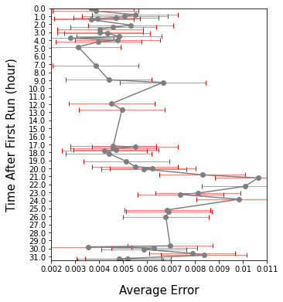
Test Stability of IonQ QPU
Get Average Value of Each Iteration
(Average of Absolute Value)
Errors
->
Average Errors
->

Slide 4
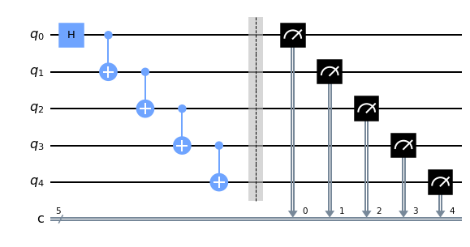
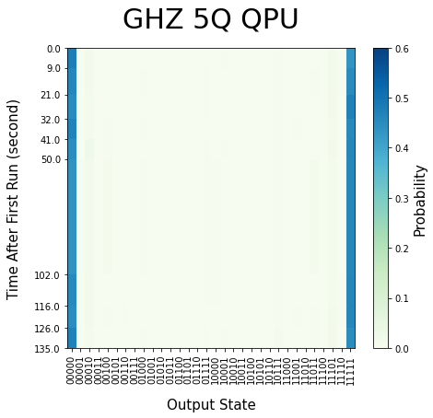
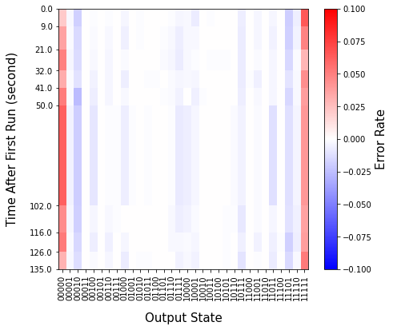
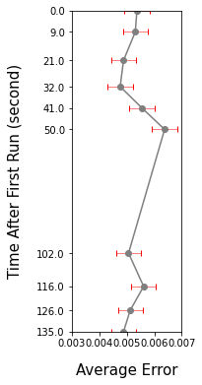
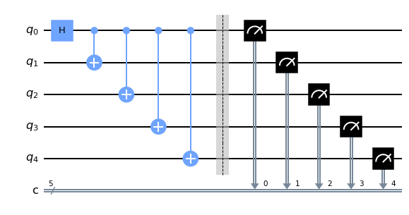
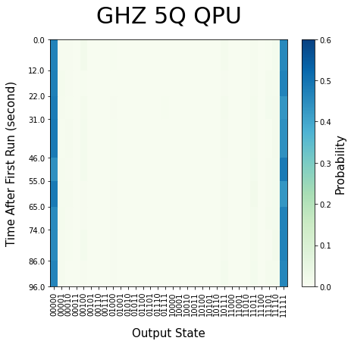
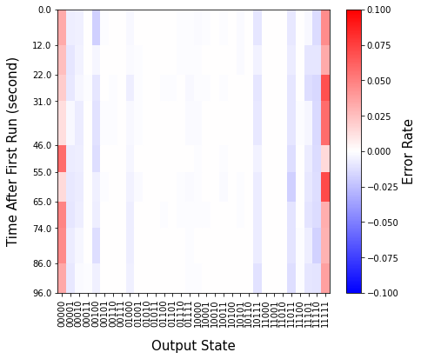
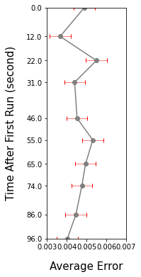
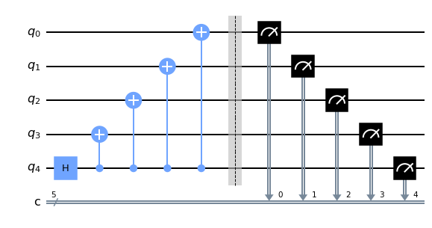
Test Stability of IonQ QPU
GHZ Circuit
Probability
Errors
Average
Error
Total
Average
error
Circuit1
0.0055
Circuit2
0.0053
Circuit3
0.0046

Slide 5
Discussion
Start
〮〮〮
QPU Queue
Finish

Slide 6
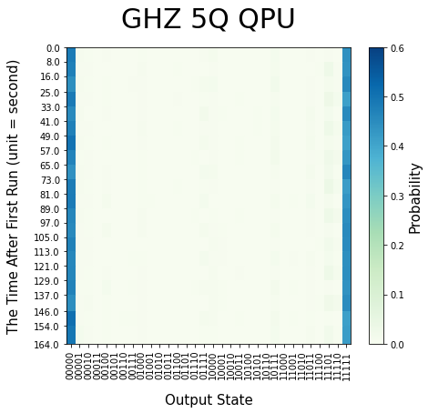
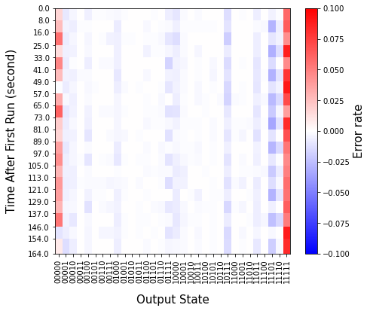
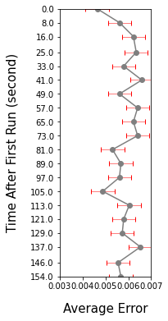
Test Stability of IonQ QPU
Odd Iteration
Even
Iteration
Probability
Errors
Average
Error

Slide 7
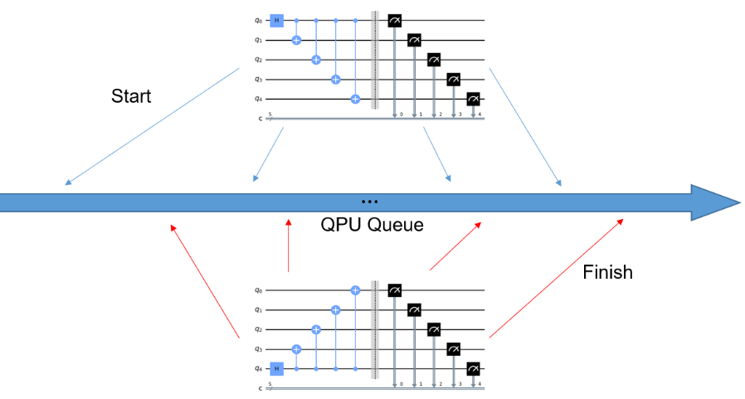
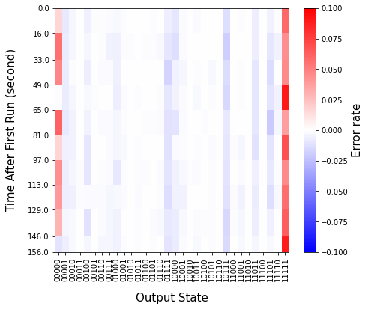
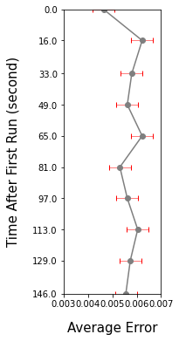
Test Stability of IonQ QPU
GHZ Circuit
Errors
Average
Error
Total
Average
error
0.0053
0.0057

Slide 8
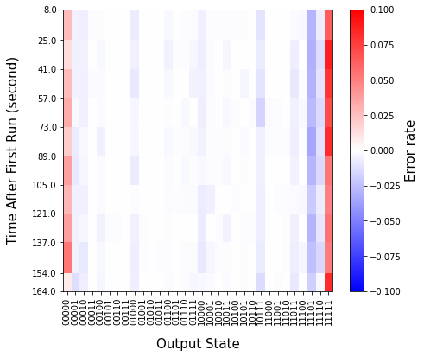
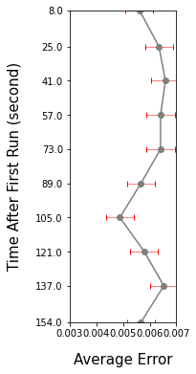
Test Stability of IonQ QPU
GHZ Circuit
Errors
Average
Error
Total
Average
error
0.0046
0.0060

Slide 9
Test Stability of IonQ QPU
Average
Error
Odd Iteration
error (00001,11110)
0.0068
error (00010,11101)
0.0059
error (00100,11011)
0.0078
error (01000,10111)
0.0195
error (10000,01111)
0.0186
Even Iteration
error (00001,11110)
0.0157
error (00010,11101)
0.0264
error (00100,11011)
0.0127
error (01000,10111)
0.0205
error (10000,01111)
0.0068

